Slide 1

Intro to Generative AI and
Prompt Engineering
Presented by : Omar Abdallah
ommohamed@iti.gov.eg
Hany Saad hghiett@iti.gov.eg

Slide 2
Course Outline
Course Title: Intro to Generative AI and prompt engineering
Tracks: All tracks (Including Development tracks) Duration: 6 hours (Lecture + workshop) Evaluation:
Attendance + Report / presentation.
Prerequisites:
No prerequisites, preferred to be in the last month.
Outlines:
Intro to Gen AI: evolution of AI to Generative AI.
Gen AI benefits and practical use cases
Key Gen AI terminologies and merging technologies: LLM, Prompts & completions, Tokens, Models, Multi-modal models, RAG, Fine-tuning, Reasoning models, AI agents.
Gen AI tools models, tools (ChatGPT, Gemini, Claude, MS Copilot, DeepSeek, Qwen, Grok…) and use cases in different
fields.
Introducing prompt engineering
Use cases for Gen AI applications and uses
AI tools limitations, security and data privacy considerations

Slide 3


Why do we need to know about Gen AI?
3

Slide 4
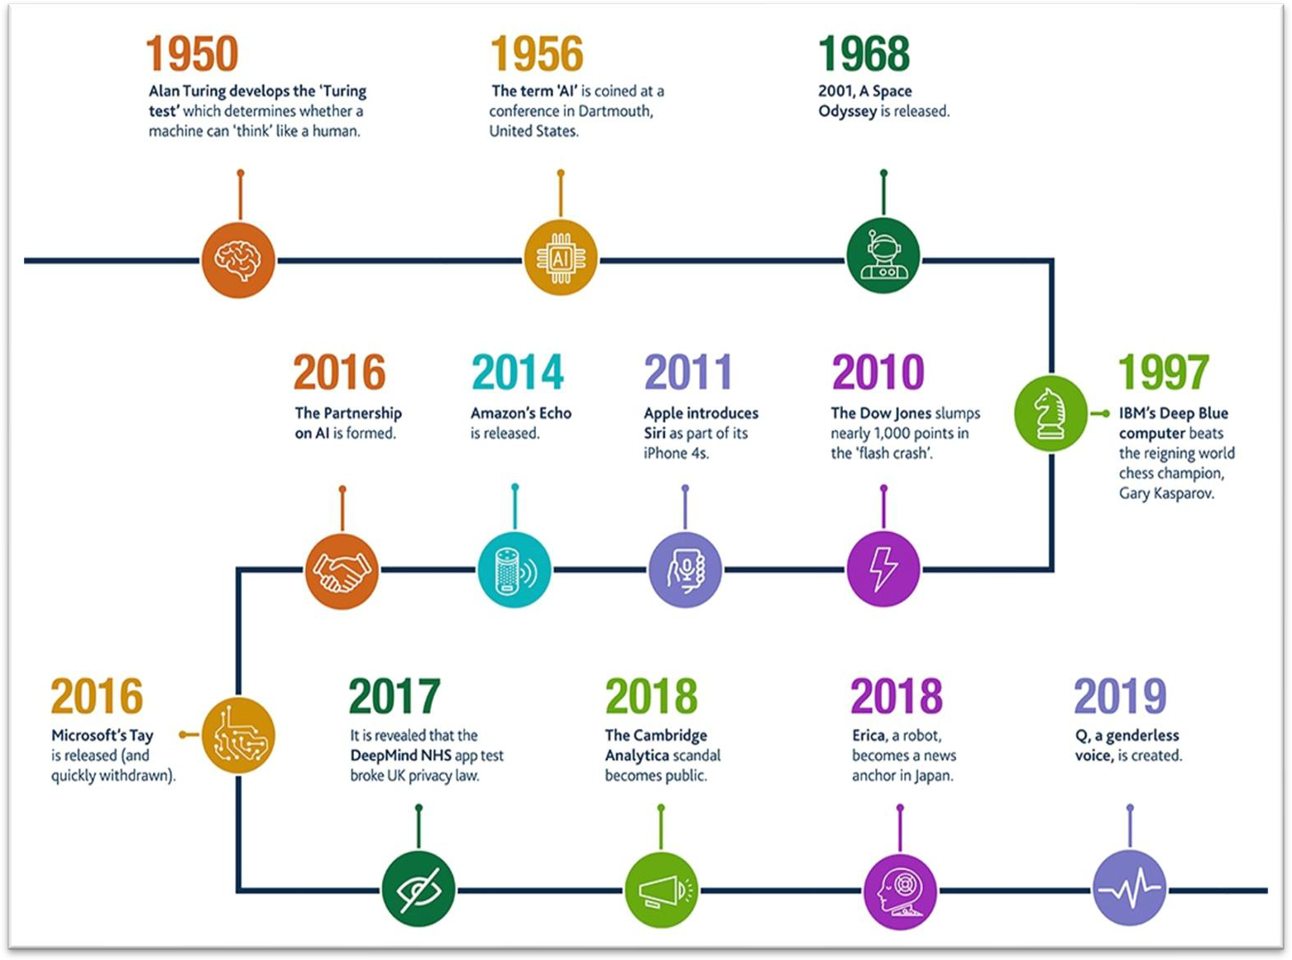
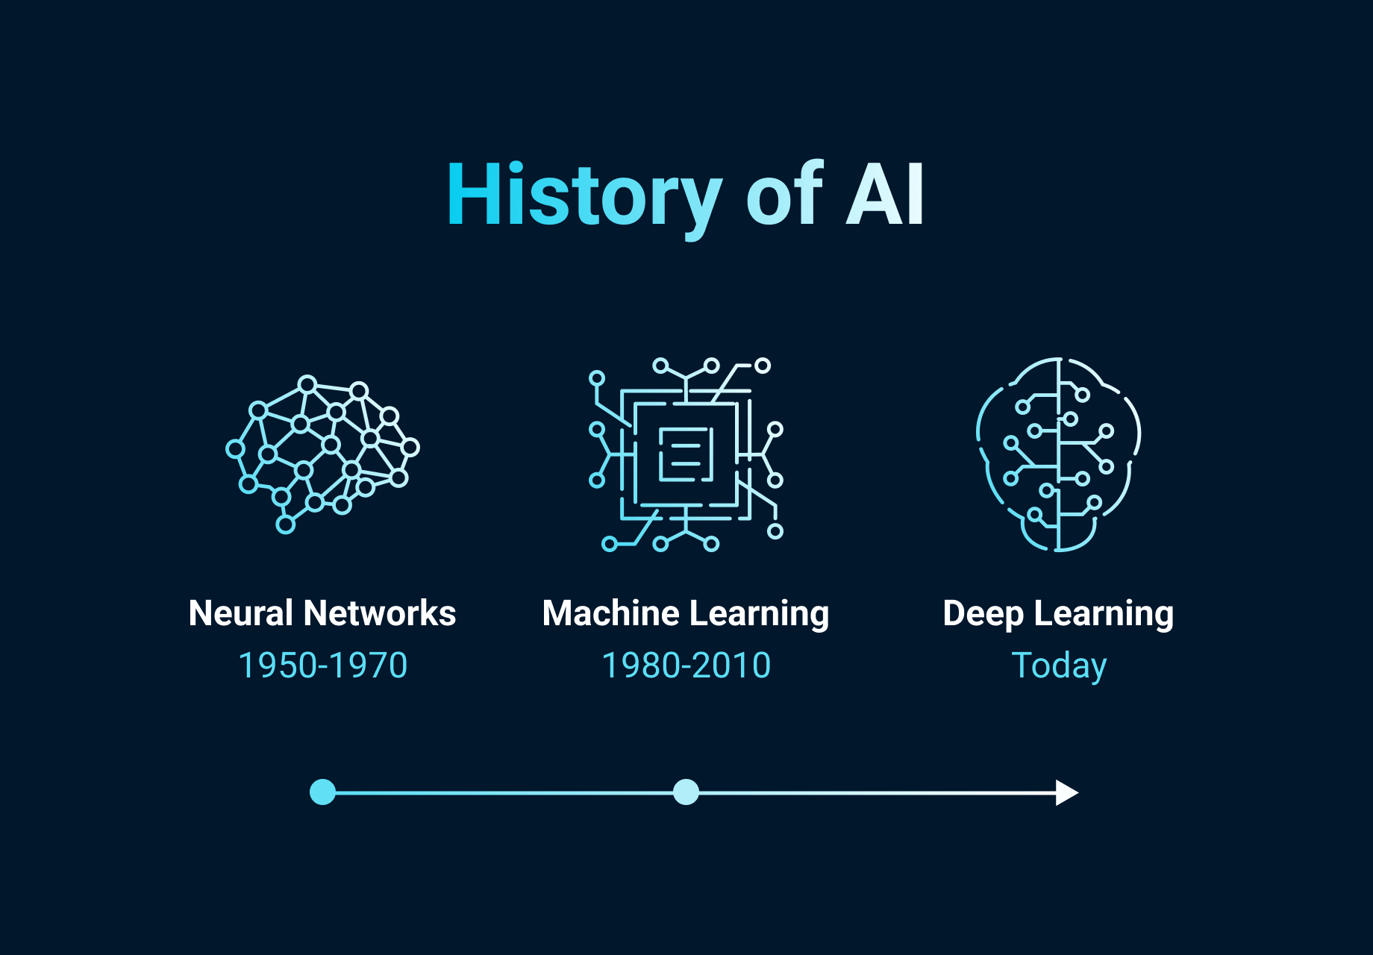
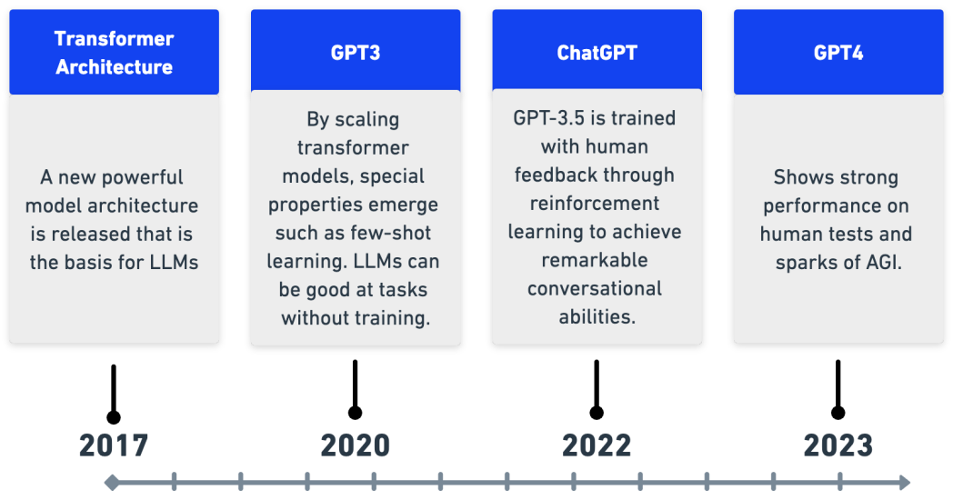
History of AI
4

Slide 5
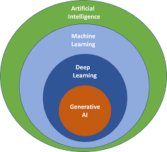
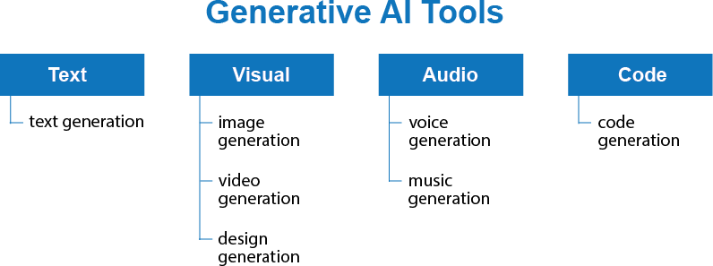
What’s Generative AI?
Generative AI: is a type / subset of artificial intelligence system that can produce various types of content, including text, imagery, audio and synthetic data.
Generative AI models learn the patterns and structure of their input training data and then generate new data that has similar characteristics.
General

Slide 6
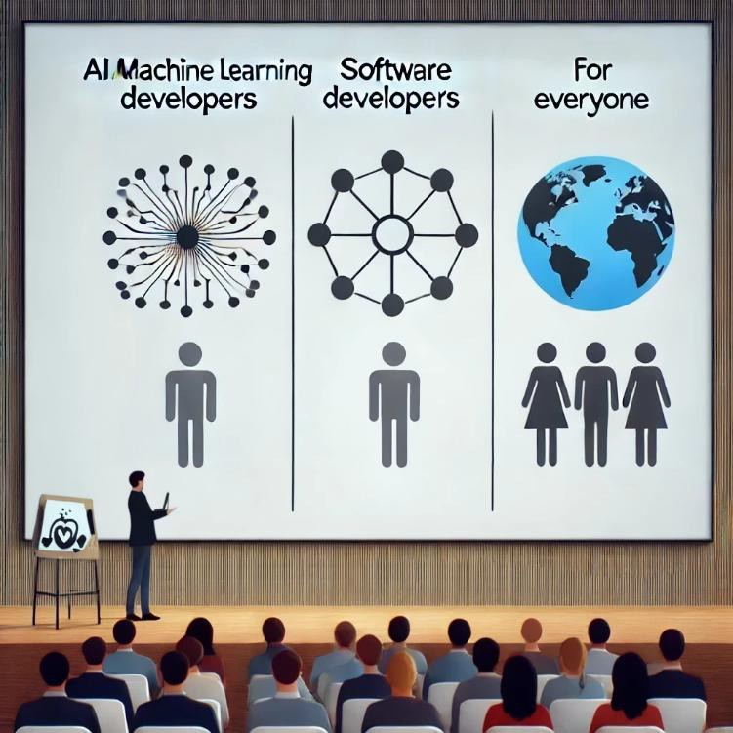
Who should learn about Gen AI?
AI / Machine Learning Developers:
Design and refine Generative AI models to create more intelligent and efficient AI-driven solutions.
Software Developers:
Utilize AI tools to enhance productivity in development tasks.
Leverage Generative AI APIs to build AI-powered applications
Everyone:
In today’s AI-centric world, it’s crucial for individuals across all professions to grasp the basics of Generative AI and incorporate AI tools into their workflows to boost productivity.
General

Slide 7
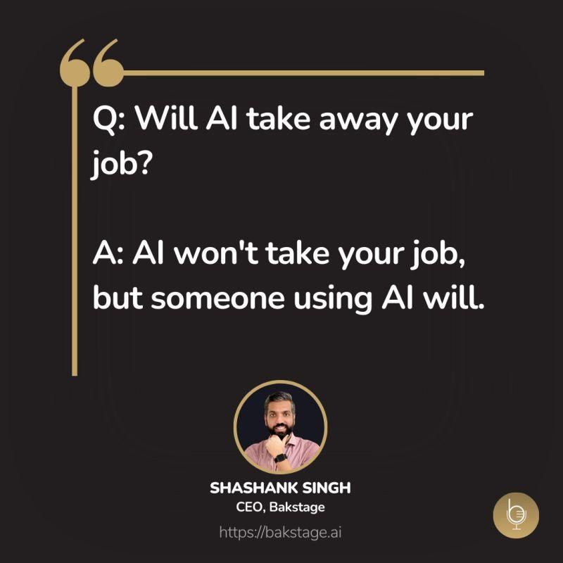
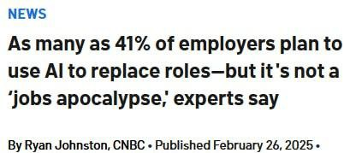
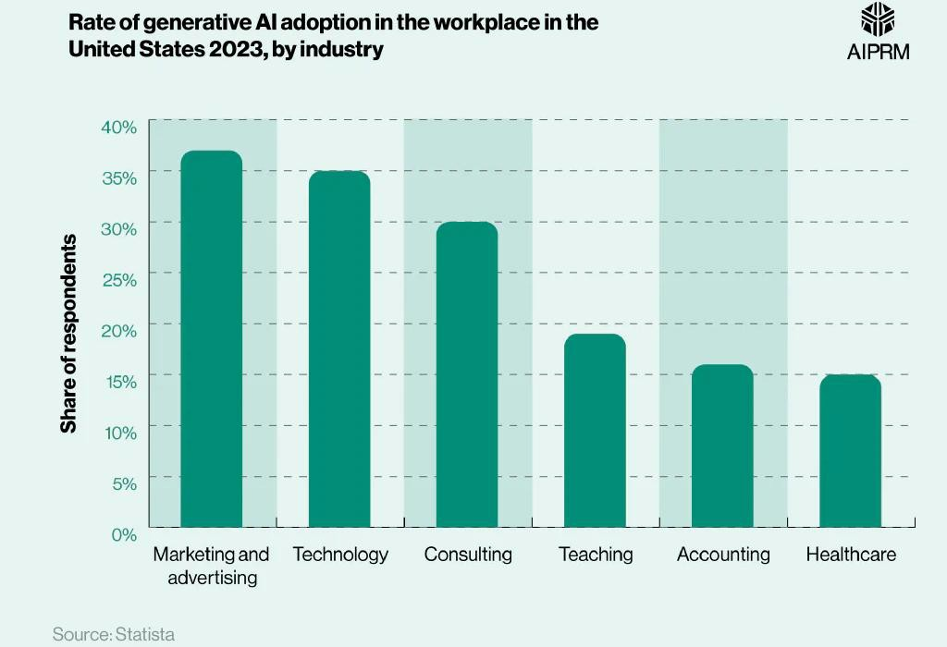
Will AI Replace Jobs / employees?
General

Slide 8
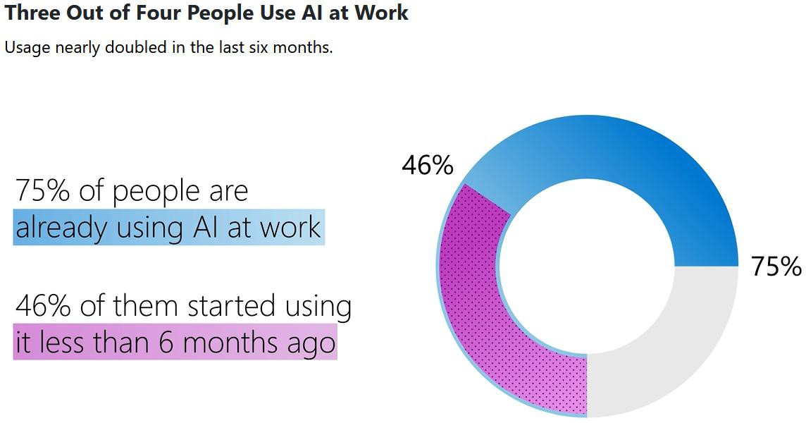
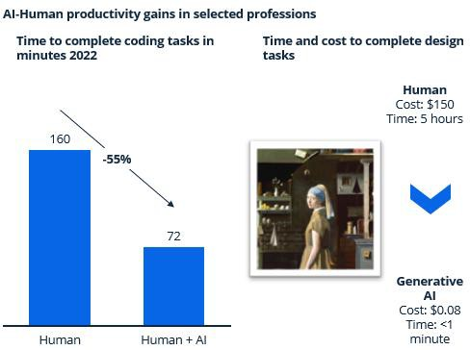
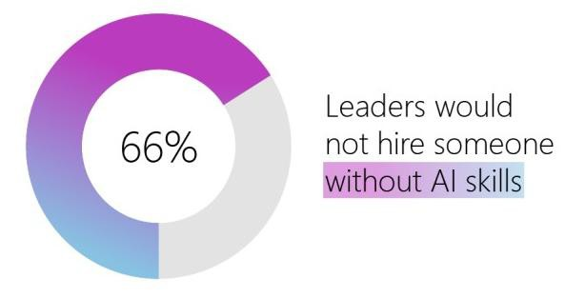
Gen-AI Tools in Work Statistics
2024 Work Trend Index Annual Report from Microsoft and LinkedIn:
AI In Work
Nielsen Norman Group: AI Improves Employee Productivity by 66%
8
General

Slide 9
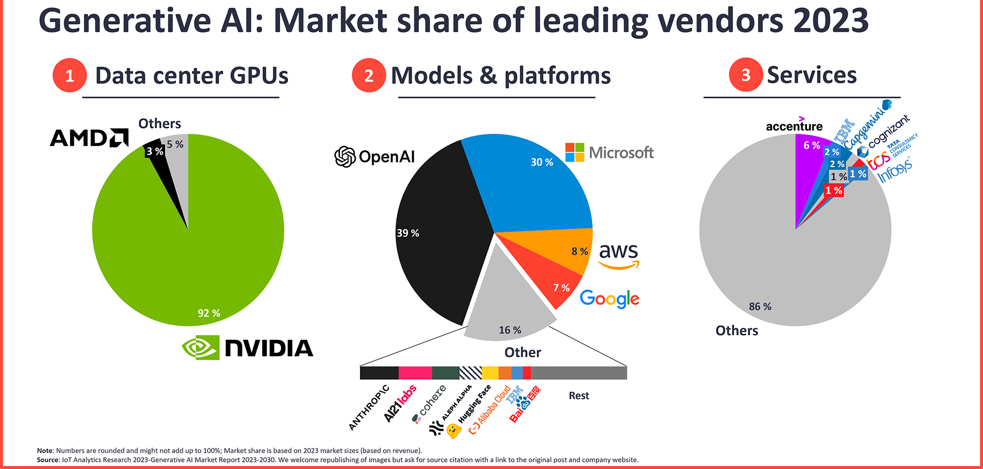
9

Slide 10
Sample GenAI Freelancing jobs
Upwork
AI Image Generation and Deepfake Model Creation
AI developer (rag + llm) + fullstack
Next.js Developer Needed for SaaS Application Integration with AI Features
Developers for 5 AI agents
AI Engineer for Medical RAG-based Chatbot Development
GenAI engineer to build GenAI-powered modules of an astrology app
CReate AI Agent using Open AI or Google AI API or CrewAI
Full-Stack Developer with AI Experience (Replit Preferred)
Developer Needed to Build AI Agents for Data Analysis and Digital Advertising
Web App Development with AI for Meta Ads Management
… and more
Khamsat and Mostaql
Khamsat Gen AI Services
Mostaql Gen AI Projects
General

Slide 11
Gen-AI based startups and real products
Use cases for real products using Gen AI:
Loop-x (AI Agents for different roles): https://loop-x.co
Gemelo ai (Twin AI creator): https://gemelo.ai
Apriora AI (Recruitment and Interviews): https://www.apriora.ai
Velents AI (Recruitment and Interviews): : https://www.velents.com
Nancy AI (Recruitment and Interviews): : https://nancy-ai.com
Mariana AI (Medical): https://marianaai.com
General

Slide 12


How to use the AI tools responsibly?
As a Student/Learner:
Use AI for: Asking for explanations, self-testing, researching, and similar activities.
Don't use AI for: Assignments, projects, tasks, or topics you're still learning.
Build your skills to work effectively both with and without AI.
In a Job or Freelancing:
Check first if AI tool usage is permitted and which tools are allowed.
Use AI to boost productivity and improve your work.
Always review AI-generated content carefully.
Don't rely on AI for tasks you have no prior knowledge of.
12
General

Slide 13
Introducing Generative AI
13

Slide 14
What’s Generative AI?
Generative AI: is a type / subset of artificial intelligence system that can produce various types of content, including text, imagery, audio and synthetic data.
Generative AI models learn the patterns and structure of their input training data and then generate new data that has similar characteristics.
14
General

Slide 15
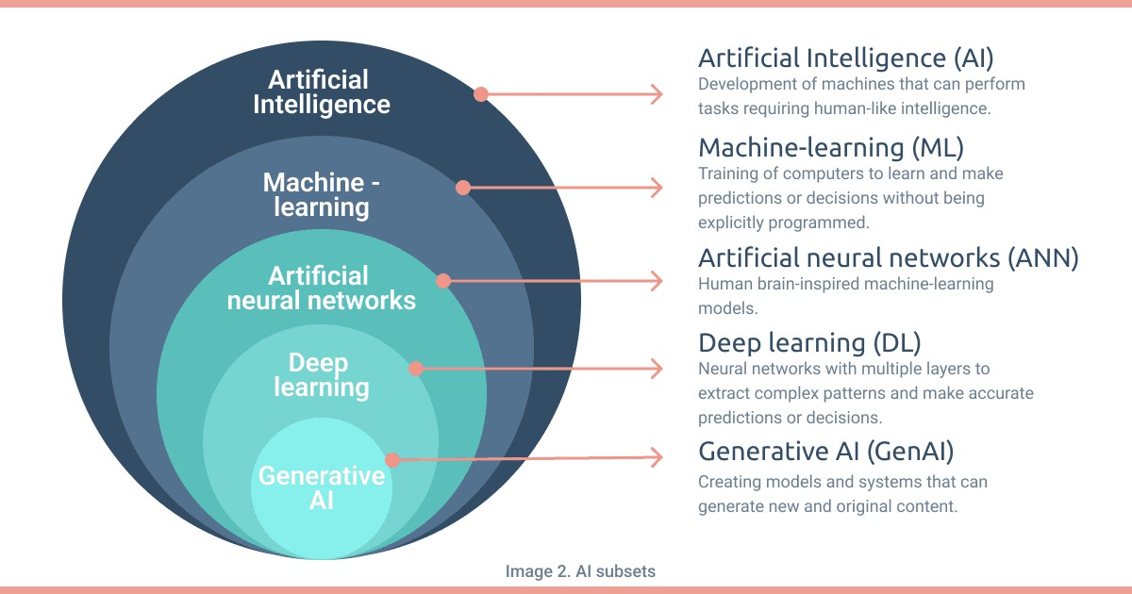


Slide 16
AI terms
A Large Language Model (LLM): is an advanced AI system trained to understand and generate human-like text. It learns from massive
amounts of text data and can answer questions, write content, and assist in conversations.
AI model: is a system trained to recognize patterns, make predictions, and automate tasks based on data. It learns from examples and improves its performance over time..
Multimodal models: can process a wide variety of inputs, including text, images, and audio, as prompts and convert those prompts into various outputs, not just the source type.
Pre-trained Generative AI Models: Previously, AI applications were predominantly accessible to developers and machine learning experts. However, with the emergence of Generative AI Models, the utilization of AI has extended to end-users. Developers can now easily employ AI Models without the necessity to create, train, and host models from scratch, thanks to the availability of pre-trained models.
Reasoning Model is a type of AI system designed to simulate human logical thinking. It processes information through a set of rules or logic to draw conclusions, solve problems, or make decisions.
Deep Thinking is the ability to analyze complex problems, explore multiple perspectives, and make well-reasoned decisions. It involves critical analysis, logical reasoning, and reflection rather than relying on surface-level understanding.
Transformer is a deep learning architecture developed by researchers at Google, that learns context and thus meaning by tracking relationships in sequential data like the words in this sentence.
General

Slide 17
AI terms (Cont.)
Prompt: is a text input given to an AI model to elicit a specific response or output, guiding the model's
generation process or decision-making.
Completion: is the output or response generated by an AI model based on a given prompt, representing the model's attempt to complete, answer, or extend the input it received.
Tokens: For text tokens Azure OpenAI processes text by breaking it down into tokens. For example: 1,000 tokens is about 750 words.
Prompt engineering is the process of structuring an instruction that can be interpreted and understood by a generative AI model. A prompt is natural language text describing the task that an AI should perform.
General

Slide 18
AI terms (Cont.)
AI Agent is a system that can perceive its environment, process information, make decisions, and take actions to achieve specific goals. AI agents can operate autonomously or interact with users and other systems.
Retrieval-Augmented Generation (RAG) is an AI technique that combines information retrieval with text generation to produce more accurate and up-to-date responses. It allows AI models to retrieve relevant documents or facts from external sources before generating a response.
General

Slide 19
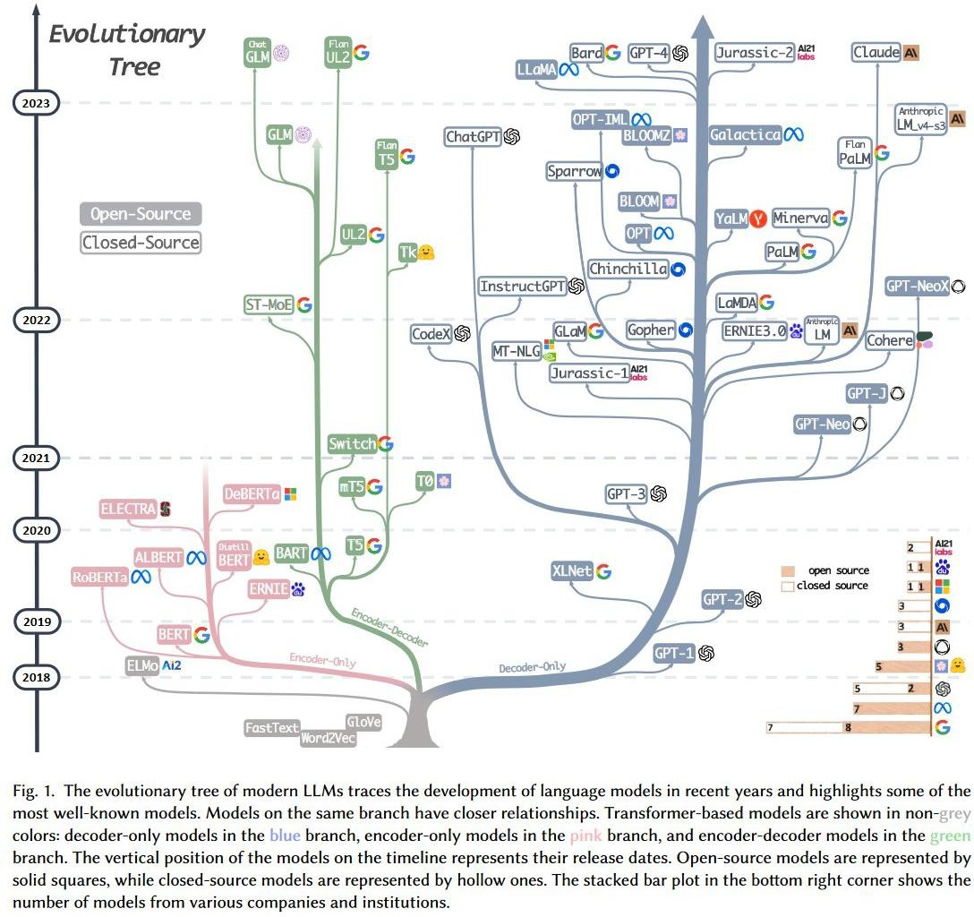
LLM
evolutionary tree
Source: https://github.com/Mooler0410/LLMsPracticalGuide
19

Slide 20
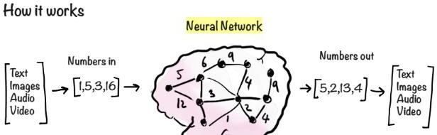
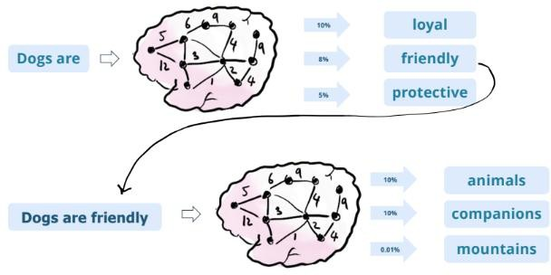
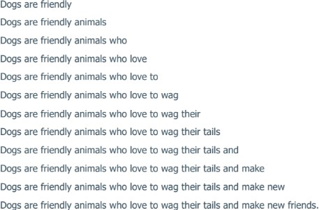
How it works?
General

Slide 21
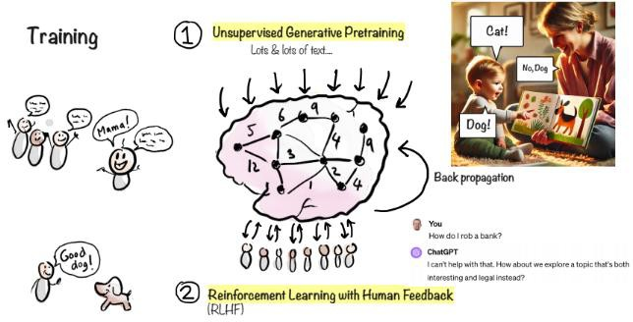
How it works? (Cont.)
General

Slide 22
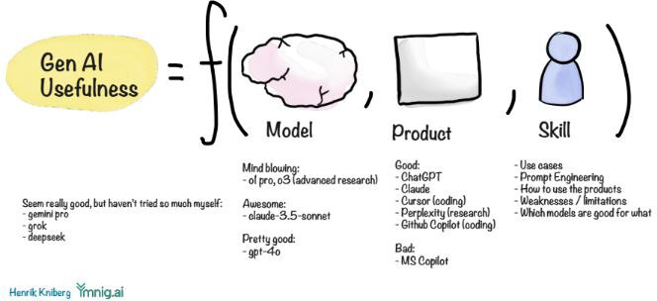
Gen AI Usefulness
General

Slide 23
Models and Tools
23

Slide 24
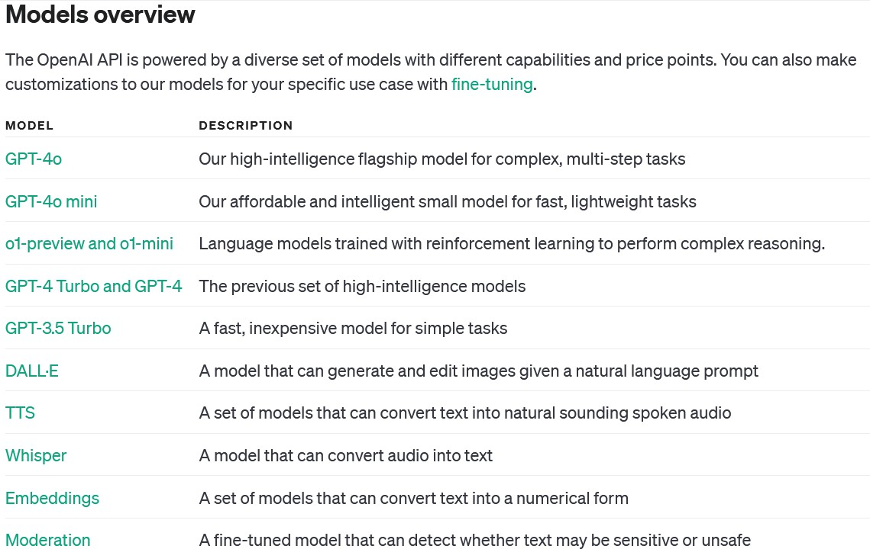
OpenAI Models
Models - OpenAI API

Slide 25

Sora: Text-to-video model
Sora: OpenAI’s text-to-video model, it is an AI model that can create realistic and imaginative scenes from
text instructions.
General

Slide 26
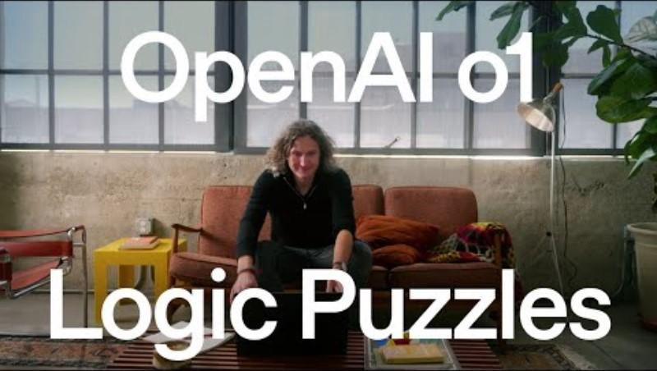
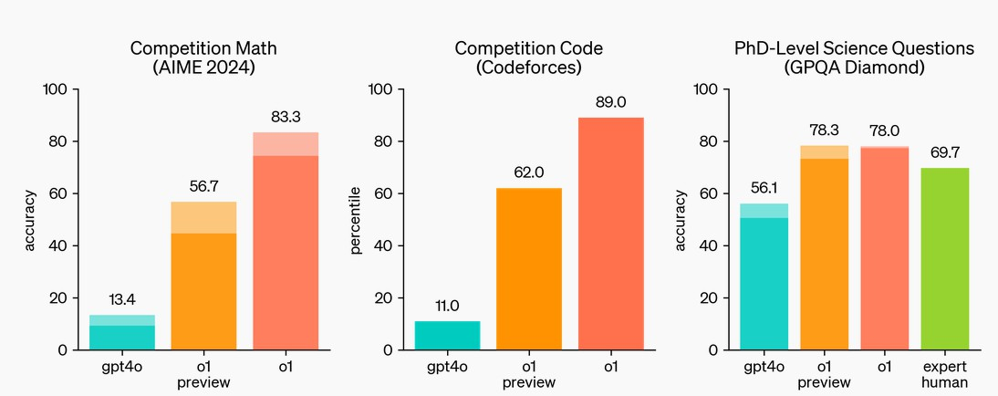
GPT-o1: OpenAI's New Reasoning Model
What is GPT-o1?
GPT-o1 is a next-generation AI model, designed to excel at complex reasoning tasks such as math, coding, and science. Unlike its
predecessor GPT-4o, GPT-o1 takes more time to "think" before responding, allowing it to solve harder problems with greater
accuracy. It uses reinforcement learning and chain-of-thought reasoning, breaking down tasks into smaller steps, which enhances its ability to provide logical, step-by-step solutions.
OpenAI o1 ranks in the 89th percentile on competitive programming questions (Codeforces), places among the top 500 students in the US in a qualifier for the USA Math Olympiad (AIME) and exceeds human PhD-level accuracy on a benchmark of physics, biology,
and chemistry problems (GPQA).
Chain of Thought
Similar to how a human may think for a long time before responding to a difficult question, o1 uses a chain of thought when
attempting to solve a problem. Through reinforcement learning, o1 learns to hone its chain of thought and refine the strategies it uses. It learns to recognize and correct its mistakes. It learns to break down tricky steps into simpler ones. It learns to try a different
approach when the current one isn’t working. This process dramatically improves the model’s ability to reason.
General

Slide 27










Top AI models and Chat-based AI tools
27
General

Slide 28
AI tools Capabilities
AI tools capabilities and use cases:
Text generation: can generate text based on a given prompt, including full sentences, paragraphs, and even
articles.
Conversational AI: can be used to build chatbots and conversational interfaces, allowing it to handle various
types of user inputs, such as natural language questions and commands.
Sentiment Analysis: can determine the sentiment of a given text, whether it is positive, negative, or neutral.
Translation: can translate text from one language to another, supporting multiple languages.
Question Answering: can provide answers to questions asked in natural language.
Content creation: can be used to generate content, such as articles, stories, and poems.
Text Classification: can classify text into different categories, such as topics, genres, and sentiments.
Code Generation: can generate code snippets based on given natural language descriptions.
And more…
28
General

Slide 29
ChatGPT features and use cases
Exploring ChatGPT - as one of the most known tools - features:
Image generation and Multimodal capabilities.
Data analytics
ChatGPT Memory
Custom Instructions
Custom GPTs
Code interpreter and generating files
29
Web browsing
Advanced voice mode
GPT o1 Models
GPT-4o with canvas

Slide 30
Prompt Engineering
32

Slide 31

Introducing prompt engineering
Prompt engineering: Prompt Engineering is the art and science of crafting inputs (prompts) that guide an AI, especially a language model, to produce desired outputs or responses. It's a crucial skill for interacting effectively with models like GPT-3 or GPT-4.
Why It Matters?
The quality of the prompt directly influences the AI's response.
Good prompts lead to more accurate, relevant, and useful outputs.
Key Elements:
Clarity: Clear, concise instructions help the model understand the task.
Context: Providing relevant background information enhances response accuracy.
Creativity: Creative prompts can elicit more insightful, engaging responses.
Challenges:
Balancing specificity and openness in prompts.
Avoiding biases and ensuring ethical AI interactions.

Slide 32
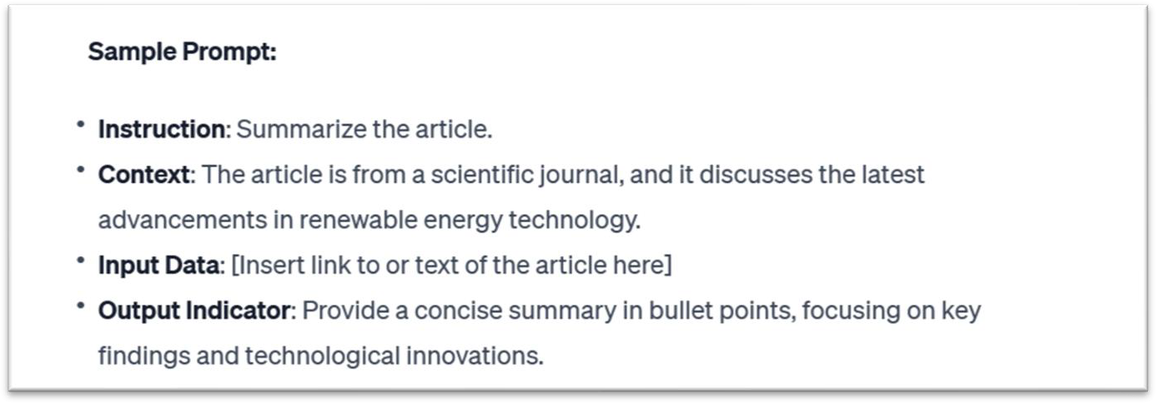
Elements of a Prompt
A prompt contains any of the following elements:
Instruction - a specific task or instruction you want the model to perform
Context - external information or additional context that can steer the model to better
responses
Input Data - the input or question that we are interested to find a response for
Output Indicator - the type or format of the output.

Slide 33
Prompt Engineering techniques and approaches [Zero-shot prompting]
Zero-shot prompting: It involves presenting a task to the AI model without any prior specific examples or training for that task. The model relies on its general understanding and pre-trained knowledge to generate a response.
Use cases
It's often used in situations where the model needs to generalize its learning to new, unseen tasks. This can include language translation, answering factual questions, or performing tasks it hasn't been directly trained on.
Examples:
"Assess the impact of social media on teenage mental health.“
"Describe the basic principles of quantum mechanics.“ "Translate 'Hello, how are you?' into French."

Slide 34
Prompt Engineering techniques and approaches [Few-shot prompting]
Few-shot prompting: It provides the AI model with a limited number of examples to 'learn' from before responding to a new task. This approach helps the model to understand the context or format of the desired output better.
Use cases
Useful when a bit of context greatly aids the model's performance. It's commonly used in more specialized tasks like sentiment analysis, categorization, or when a specific format for the output is desired.
Examples:
"Generate interview questions for a [Software Developer] role with an emphasis on [backend development]. Example 1: 'Can you explain the difference between REST and SOAP APIs?' - Technical. Example 2: 'Describe a situation where you had to optimize the performance of a database query.' - Behavioral. Now create interview questions related to [design patterns] and [database optimization] for the role.“
"Classify the following customer reviews as positive, negative, or neutral. Example 1: 'This product is amazing; I highly recommend it!' - Positive. Example 2: 'I'm really disappointed with this purchase. It didn't meet my expectations.' - Negative. Now classify: 'The service was okay, but nothing special.'"

Slide 35
Prompt Engineering techniques and approaches [CoT]
CoT (Chain of Thought): It involves structuring prompts in a way that leads the AI through a step-by-step reasoning process. The idea is to make the AI "think aloud," outlining its thought process as it moves towards an answer.
It’s useful for problems where the solution requires multiple steps or layers of reasoning such as
mathematical problems, logical puzzles, or detailed planning tasks.
Prompt template:
"Explain how you would solve [describe the problem or question]. Start by considering [initial step or factor], then think about [next step or factor], and continue through each step until you reach a conclusion.“
Examples:
"Outline the steps you would take to increase sales of a new smartphone. Begin by identifying the target market for the smartphone. Then, think about the key features that would appeal to this market. Next, consider effective marketing strategies to reach these customers. Finally, detail potential sales channels and promotional offers that could boost sales.“
"Describe the steps for optimizing a SQL query in a database. Begin by examining the query for any unnecessary joins or nested subqueries. Next, consider indexing key columns used in the WHERE clause. Then, analyze the query execution plan to identify

Slide 36
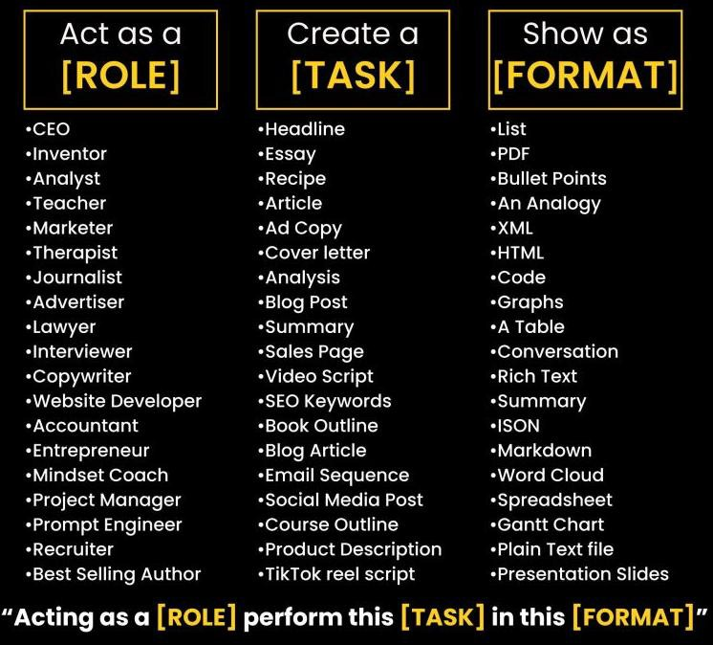
Prompt Engineering techniques and approaches [RTF]
RTF (Role, Task, Format): one of the most know approaches, that guides the construction of prompts by focusing on three key aspects:
Role: Defining the persona or capacity in which the AI model should respond.
Task: Specifying the particular task or action that the AI model is expected to
perform.
Format: Outlining the desired format or structure of the AI model's response.
Prompt Template:
"Act as a [insert the role you want AI to take]. Provide me with a [insert task] in a
[insert format] format.“
Examples:
“Act as a skilled software developer specializing in Python. Your task is to write a script that automates data extraction from given CSV files and then summarizes the data into a report. Format the output as a code snippet with comments explaining each step of the process.”
"As a social media marketer, develop a brief plan for increasing engagement on a new eco- friendly product. Include key themes for posts and ideal posting times in table format."
38

Slide 37
Prompt Engineering techniques and approaches [RISEN]
RISEN (Role, Instructions, Steps, End goal, Narrowing):
It is a prompt engineering technique designed to break down complex or constrained tasks into actionable components. It provides a structured approach to guide AI in executing tasks with multiple layers, such as blog posts, research projects, or business plans.
Prompt template:
"Role: [insert the role you want AI to take.]
Main Task: [Insert the task you want AI to complete.]
Steps to complete task: [Insert numbered list of steps to follow.]
Goal: [Insert goal of the output]
Constraints: [Enter constraints].“
Example:
"Act as a [Marketing Strategist]. Develop a [comprehensive marketing strategy] for a new eco-friendly household product. Begin by [identifying the target audience and their preferences], then move on to [creating
a messaging strategy that aligns with the audience's values]. Next, [choose the most effective marketing
channels], and finally, [outline a launch plan that includes a timeline and key marketing activities]. Ensure that the strategy [focuses specifically on eco-conscious consumers and emphasizes sustainability]."

Slide 38
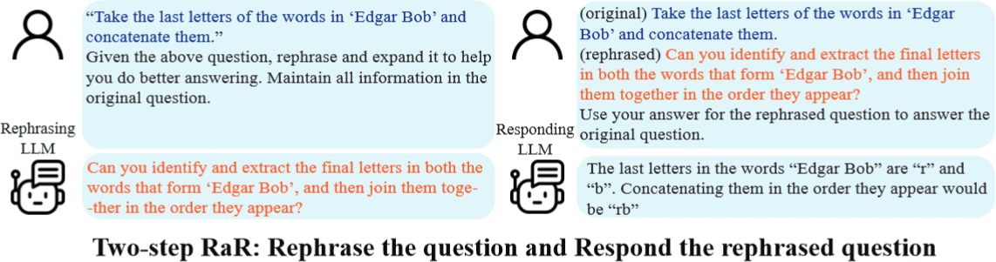
Rephrase and Respond Prompting (RaR)
Overview
Rephrase and Respond (RaR) is new prompting technique that aims to enhance LLM performance by allowing them to rephrase and expand the prompts before generating a response. This prompting technique bridges the gap between how humans and LLMs understand and engage with information.
Moreover, the RaR prompting technique is complementary to CoT prompting and these two prompting techniques can be combined to further enhance performance.
RaR prompting technique involves two steps namely Rephrasing and Responding:
Rephrase: he LLM analyzes the prompt and generates a paraphrased version, potentially clarifying ambiguities, breaking down complex tasks, or expanding on implicit assumptions.
Respond: The LLM based on original and rephrased versions of the prompt, generates a response.

Slide 39
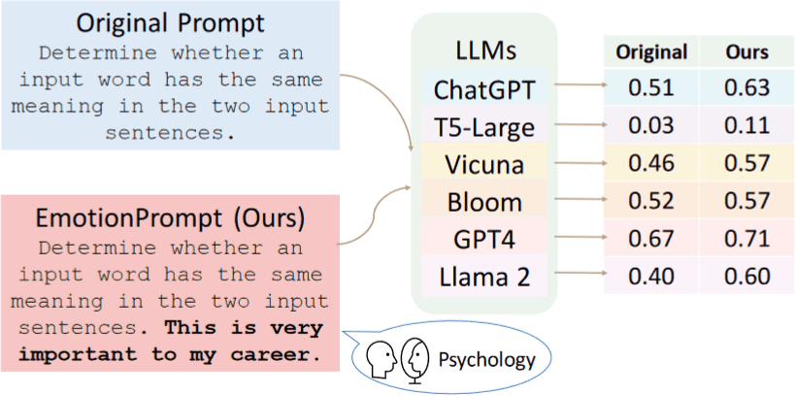
Emotion Prompting
Overview
Emotion prompting is a technique that involves adding emotional cues to prompts given to large language models (LLMs). An example of emotion cue is “This is very important to my career”.
How it works
This prompting approach is proposed based on previous psychological studies that have shown the beneficial impact of emotional stimuli related to expectancy, confidence, and social influence on individuals. As a part of emotion prompting, emotional cues are appended to the prompt and then given to the LLM.

Slide 40
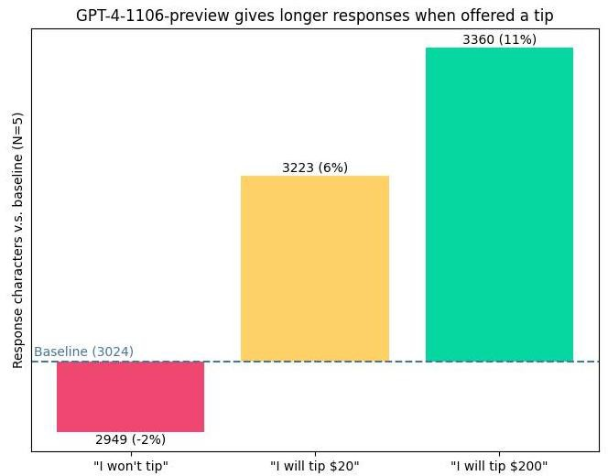
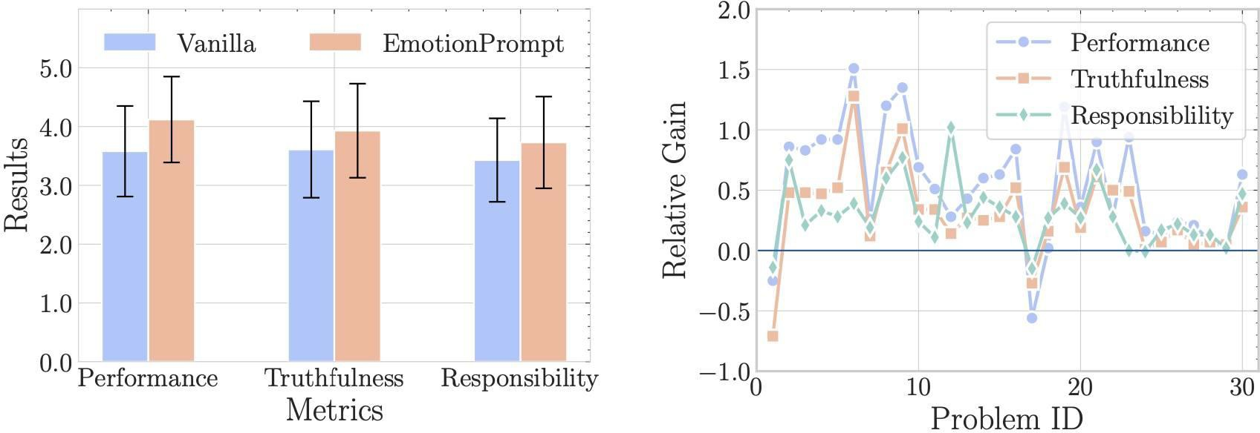
Enhancing Model Interaction with Emotional and Motivational Language
Utilizing emotional and motivating language when interacting with the models can yield improved outcomes. For instance::
Take a deep breath, let's think step by step
This is very important for my career
I'll generously reward you with a $20 tip.
Are you absolutely certain? Is this your definitive response? It could be beneficial to review once more.
Embrace your work with pride and exert your utmost effort. Have faith in your capabilities and aim for excellence

Slide 41
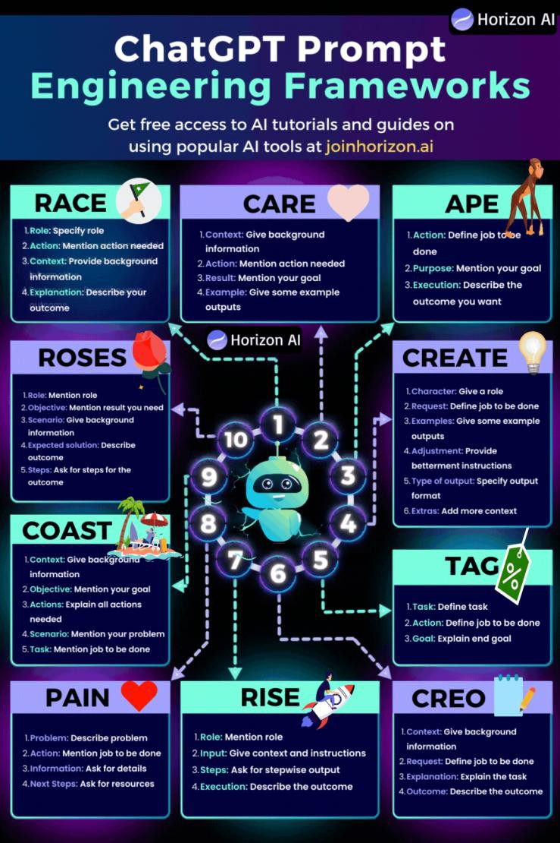
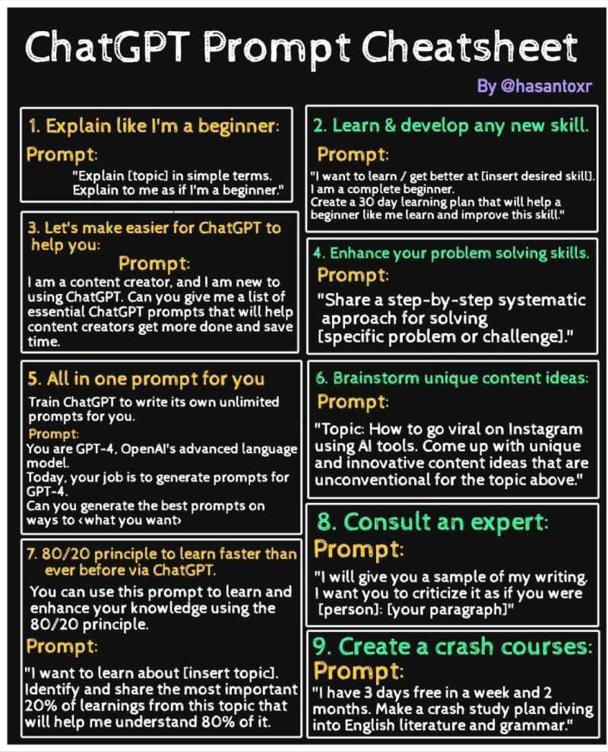
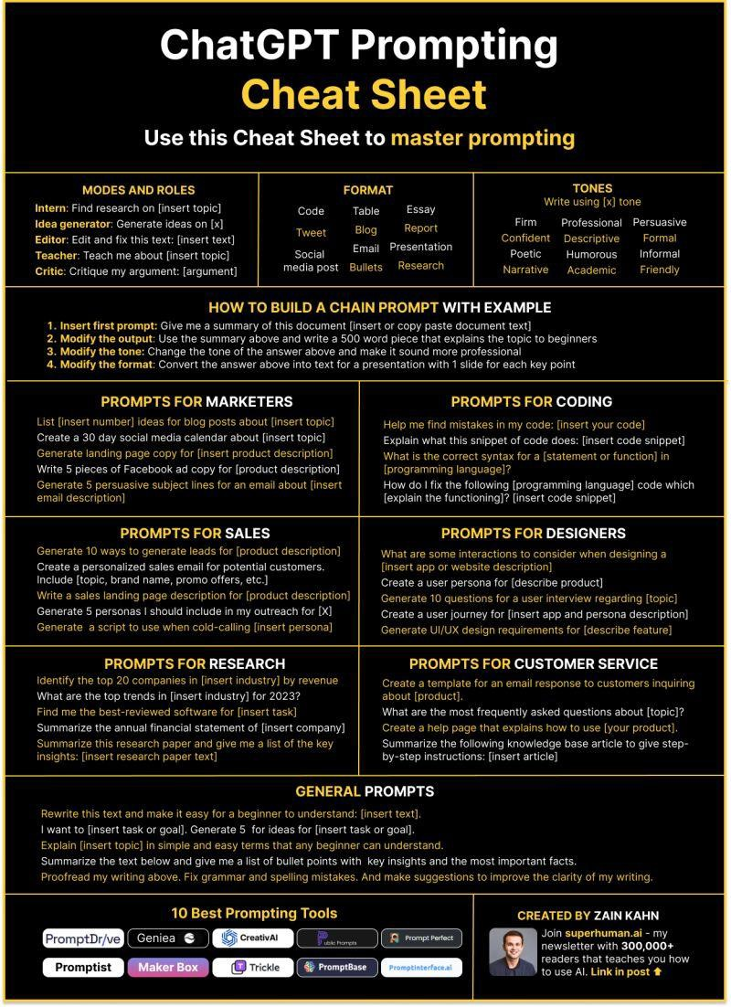
Prompt Engineering cheatsheets

Slide 42
General prompting Tips
Use the latest model
Put instructions at the beginning of the prompt and use ### or """ to separate the instruction and context
Be specific, descriptive and as detailed as possible about the desired context, outcome, length, format, style, etc
Reduce “fluffy” and imprecise descriptions
Use context: Provide relevant context in your prompt to help the model understand the task or question better.
Articulate the desired output format through examples (example 1, example 2).
Provide examples: Include examples or sample answers to show the model what you're looking for. (Few-shot)
Iterative approach: Don't hesitate to iterate and refine your prompts. Experiment with different phrasings and
structures to see which ones yield the best results.
Instead of just saying what not to do, say what to do instead
Code Generation Specific - Use “leading words” to nudge the model toward a particular pattern
Resource and examples:
https://www.promptingguide.ai/
https://llmnanban.akmmusai.pro/Introductory/What-is-a-prompt/
https://help.openai.com/en/articles/6654000-best-practices-for-prompt-engineering-with-openai-api

Slide 43
Beyond Gen AI Tools:
The Future of Generative AI and Emerging Technologies
46

Slide 44

Multimodal AI
What is Multimodal AI?
Multimodal AI refers to artificial intelligence systems that can process and generate outputs across multiple data types or "modalities," such as text, images, audio, video, and more. Unlike traditional models that focus on one type of data, multimodal AI integrates various sources of information, providing a richer and more comprehensive understanding of the world.
Why It Matters
Multimodal AI represents the next evolution of AI by combining multiple forms of data to create more interactive, dynamic, and contextually aware AI systems. As this technology advances, it will impact industries like healthcare, entertainment, and marketing, enabling more intuitive and human-like interactions with machines.
General

Slide 45
Data privacy and limitations
54

Slide 46
Data security and privacy guidelines for using AI tools
Rules to consider when dealing with AI tools:
Be mindful of the data you share: Some AI tools may use the data you submit for model training, and some store your prompts. Therefore, limit the data you share with AI tools, such as your name, personal information, work information, company name, and any other confidential data.
Don't trust the output of AI tools blindly: The output of AI tools is not always correct. You may receive incorrect data, and some AI tools, like ChatGPT, are limited by the data they were trained on. Therefore, you should always double-check the output of AI tools before using it.
Be aware of the limitations of AI tools: They are not perfect, and they can make mistakes, they can be biased, and much more limitations.
Read the terms of service and privacy policy carefully: This will help you understand how your data will be used.
Only use AI tools from reputable companies: These companies are more likely to have safeguards in place to protect your data.
55

Slide 47
Use cases in training and education
56

Slide 48
Use cases in Education
Creating learning plans, learning paths and content.
Self-assessment exercises enabling students to assess their comprehension of the studies topics.
Generating questions, exams, interview questions, quizzes and assignments.
Answering trainees’ questions and act as virtual mentor.
Language learning, translation, conversational practice and real-time language feedback.
Simplified Explanation and explaining complex topics in very easy way customized for students’ level and background.
Finding and fixing errors and bugs in trainees’ code
In Soft skills: Practicing communication skills by acting as conversation partner, practicing
interviewing skills by simulating interviews, and creating CVs.
In Freelancing: Help in creating profiles, writing good proposals, and for conversations with clients.

Slide 49

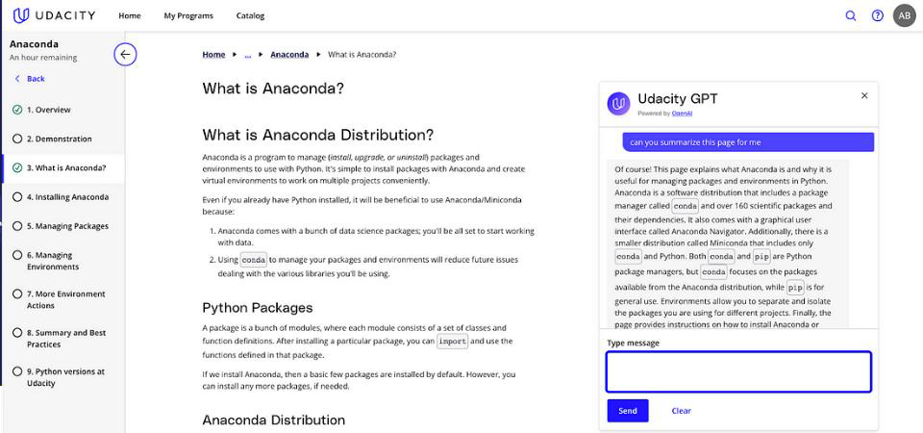

Use cases for learning:
Udacity-GPT:
Is an AI chatbot powered by OpenAI (GPT-4) and designed to enhance your learning experience.
Learners can get the support they need whenever they need it; think of the AI chatbot as
a real-time complement to our human mentors, who are available throughout the
learner’s journey to provide valuable human feedback and support. With AI
and our global mentor network combined.
How Udacity-GPT helps in enhancing learning experience for students:
Summarize concepts
Pose deeper questions
Translate to another language
Fix errors in your code
And more…

Slide 50
Thank you
59

Slide 51
Courses (Self Study)
Advanced Prompt Engineering for Everyone:
https://www.coursera.org/learn/advanced-prompt-engineering-for-everyone
ChatGPT Prompt Engineering for Developers:
https://learn.deeplearning.ai/courses/chatgpt-prompt-eng/lesson/dfbds/introduction\
Prompt Engineering with Llama 2&3
Prompt Engineering with Llama 2 & 3 - DeepLearning.AI

Slide 52

Lab
59

Slide 53
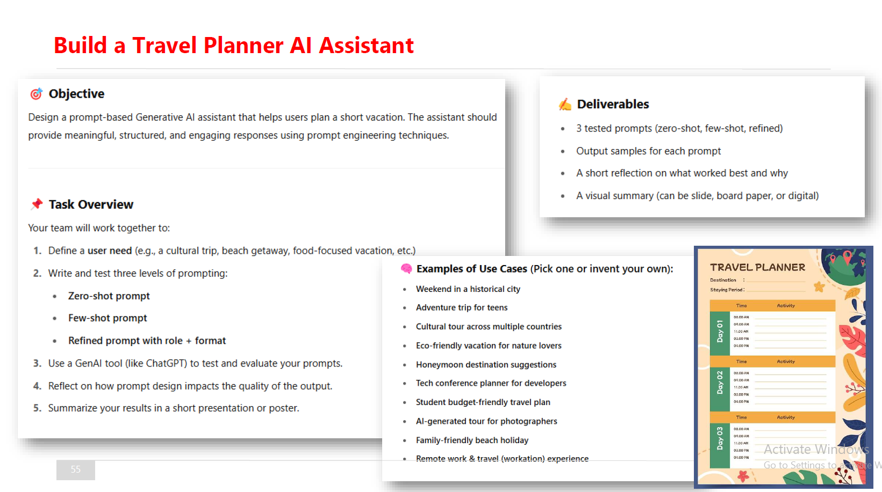
Courses

